Slide 1

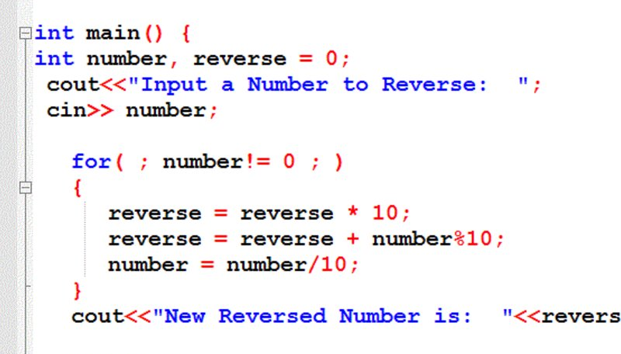

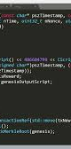
Project Playing Card
Presented By: Tenzin Tashi

Slide 2
Outline
The Unicode Character
Game Map
Coding

Slide 3
The Unicode Character

Slide 4
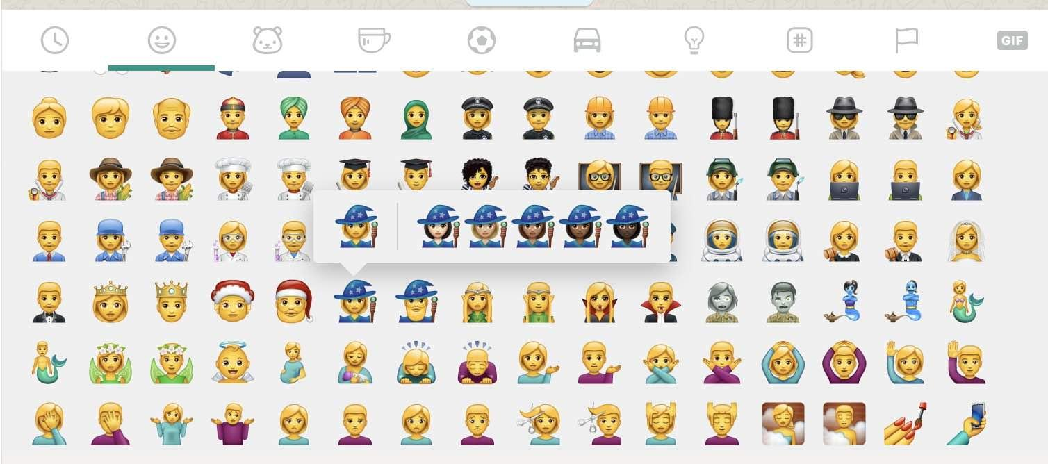
Unicode
Character
Unicode are basically the unique number given to every character independent of what platform, device, application or language you use.
Some example of Unicode character are:

Slide 5
The Character I used in my code
The Unicode character I used are:
Club ♣ (“\u2663”)
Diamond ♢ ("\u2662”)
Heart ♡ ("\u2661”)
Spade ♠ (“\u2660”)
Copyright © (“\u00A9”)

Slide 6
Game Map

Slide 7

Main
Menu
Credit
Play
Exit
Start
Buy Coin
Bet
Show
Fold

Slide 8
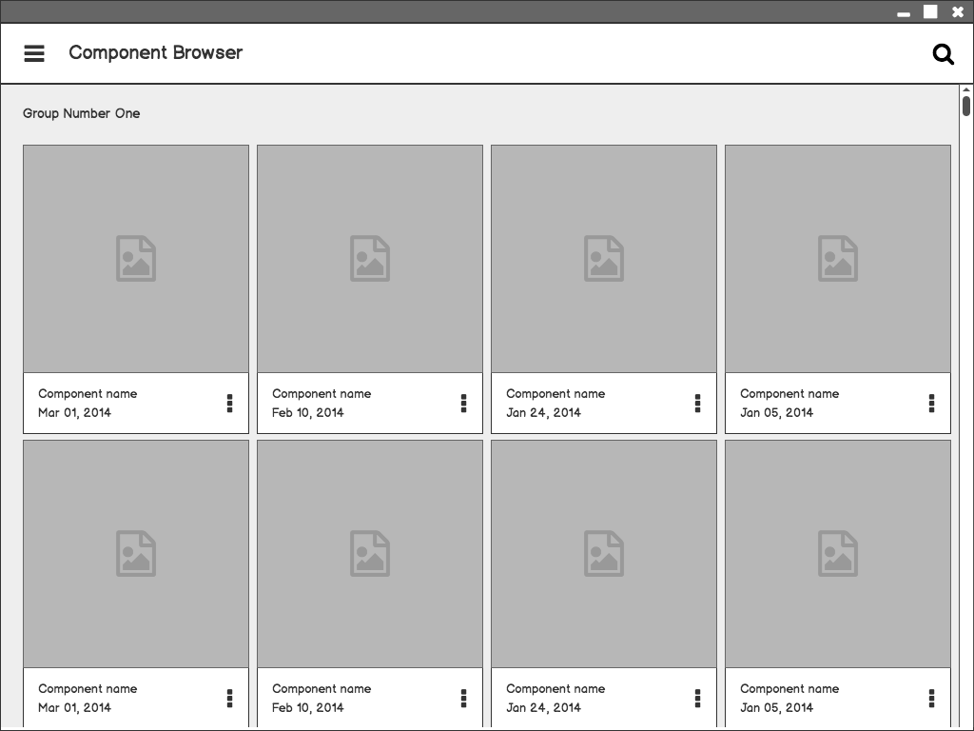
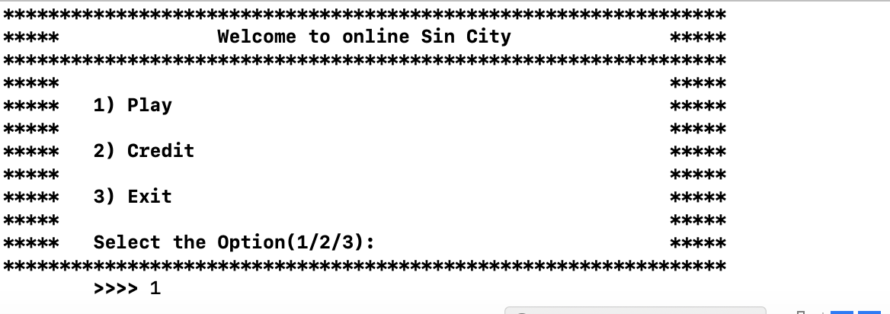
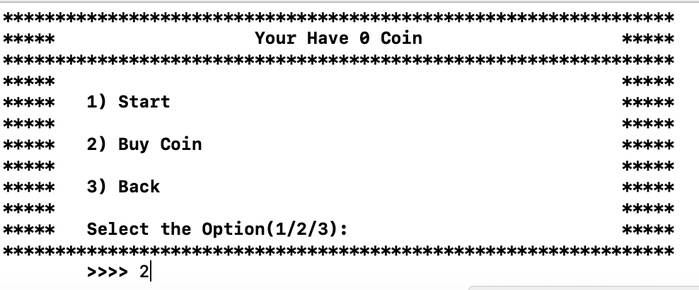
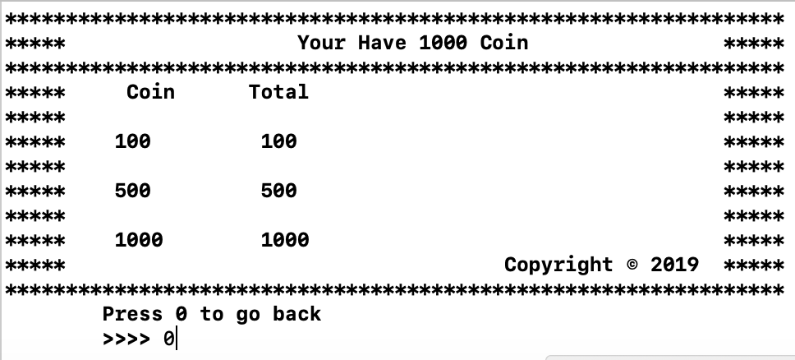
Component Browser
Main Menu
0 Coin
After you but coin
Balsamiq Tip | Use the Balsamiq add-on to make your own wireframe.

Slide 9

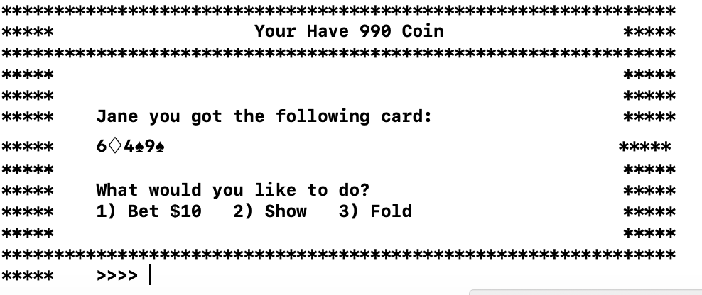
Component Detail
Display Your Card
Option to either
Bet
Show or
Fold

Slide 10
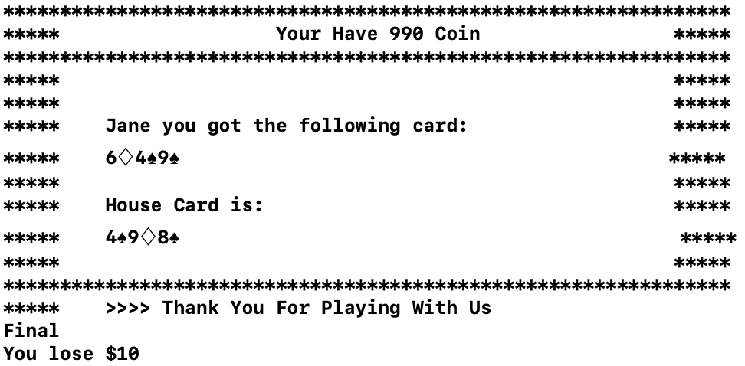
Component Detail
Display Your Card
&
Computer’s Card
You Lose Because Computer has higher card than the player

Slide 11
Coding

Slide 12
// class to get a rank of a playing card
class Rank{
private:
string RankArray[13] = {"2","3","4","5","6","7","8","9","10","J","Q","K","A"};
public:
string getRank(int);
};
string Rank::getRank(int x){
return RankArray[x];
}

Slide 13
// class to get a suit of a playing card
class Suit{
private:
//uni-code for club, diamond, heart, and spade respectively
string SuitArray[4] = {"\u2663","\u2662","\u2661","\u2660"};
public:
string getSuit(int);
};
string Suit::getSuit(int x){
return SuitArray[x];
}

Slide 14
// custom data type of both rank and suit
struct Card {
string Xrank[6];
string Xsuit[6];
};

Slide 15
// class to generate a random card
class GenCard{
private:
Rank rank;
Suit suit;
Card card;
string cardRS[6];
int x,y;
public:
GenCard(); // default constructor
string * printCard();
};

Slide 16
GenCard::GenCard(){
srand( (unsigned) time( NULL ) );
for(int i = 0; i<6;i++){
x = rand();
y = rand();
card.Xrank[i] = rank.getRank(x % 13);
card.Xsuit[i] = suit.getSuit(y % 4);
cardRS[i] = card.Xrank[i] + card.Xsuit[i];
}
}

Slide 17
// returns the address of the cardRS array
string * GenCard::printCard(){
return cardRS;
}

Slide 18
//Selecting out the Ranks and Encoding it with special number
int returnIntValue( string a[]){
int loop = 3;
for (int Index = 0 ; Index< loop; Index++){
if(a[Index] == "2"){
return 0;
}else if(a[Index] == "3"){
return 1;
}else if(a[Index] == "4"){
return 2;
…

Slide 19
}else if(a[Index] == "J"){
return 9;
}else if(a[Index] == "Q"){
return 10;
}else if(a[Index] == "K"){
return 11;
}else if(a[Index] == "A"){
return 12;
}else{
continue;
loop++;
}
}
exit(0);
}

Slide 20
//Function to check for the winning card
bool winGame(int a[], int b[]){
//trio
if (a[0] == a[1] && a[1] == a[2] && b[0] != b[1] && b[1] != b[2]){
return true;
}else if(a[0] == a[1] && a[1] == a[2] && b[1] == b[2] && b[0] == b[1]){
if ( a[0] > b[0]){
return true;
}
}else if(a[0] != a[1] && a[1] != a[2] && b[1] == b[2] && b[0] == b[1]){
return false;
}

Slide 21
//straight
else if ((a[0]+1) == a[1] && (a[1]+1) == a[2] && (b[0]+1) != b[1] && (b[1]+1) != b[2] ){
return true;
}else if((a[0]+1) == a[1] && (a[1]+1) == a[2] && (b[0]+1) == b[1] && (b[1]+1) == b[2]){
if (a[2]>b[2]){
return true;
}
}else if((a[0]+1) != a[1] && (a[1]+1) != a[2] && (b[0]+1) == b[1] && (b[1]+1) == b[2]){
return false;
}

Slide 22
//pair
else if( ((a[0] == a[1]) || (a[1] == a[2])) && ((b[0] != b[1]) && (b[1] != b[2])) ){
return true;
}else if ( ((a[0] == a[1]) || (a[1] == a[2])) && ((b[0] == b[1]) || (b[1] == b[2]) ) ){
if (a[1]>b[1]){
return true;
}
}else if ( ((a[0] != a[1]) && (a[1] != a[2])) && ((b[0] == b[1]) || (b[1] == b[2]) ) ){
return false;
}

Slide 23
//hight card
else if ( a[2] == b[2]){
if( a[1] == b[1]){
if (a[0] > b[0]){
return true;
}
}else if (a[1] > b[1]){
return true;
}
}

Slide 24
else if (a[2] > b[2]){
return true;
}else if (a[2] < b[2]){
return false;
}
return false;
}

Slide 25
Control Flow
First
Second
Third
Fourth
Fifth
Six
Seven
Generate 6 Random Cards
Distribute first 3 to user and rest to computer
Selecting out the only Ranks out of the deck of card
Encoding the Ranks with special number
Arranging the encoded Ranks in ascending order
Checking for Winner Card
Displaying the Result

Slide 26
Questions?

Slide 27
The End
Thanks You
Tenzin Tashi
Prof: Doyel Pal
Mac 125

